Slide 1

DDL AND CONSTRAINTS
Lab 7

Slide 2
DDL - Data definition language
DDL is a standard subset of SQL that is used to define tables (database structure), and other metadata related things.
DDL or Data Definition Language actually consists of the SQL commands that can be used to define the database schema. It simply deals with descriptions of the database schema
DDL statements create, modify, and remove database objects such as tables, indexes, and users.

Slide 3
DDL - Data definition language
The most important DDL statements in SQL are:
CREATE DATABASE - creates a new database
CREATE TABLE - creates a new table
ALTER TABLE - modifies a table
DROP TABLE - deletes a table
TRUNCATE–is used to remove all records from a table, including all spaces allocated for the records are removed.

Slide 4
Create Database statement
The CREATE DATABASE statement is used to create a database.
Syntax:
Create Database <database_name>

Slide 5
Create Database statement
Example:
To create a database called "my_db“, use the
following CREATE DATABASE statement:
CREATE DATABASE my_db

Slide 6
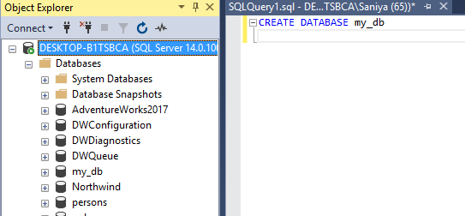
Create Database statement

Slide 7
Drop Database statement
The DROP DATABASE statement is used to delete a database.
Syntax:
DROP DATABASE <database_name>

Slide 8
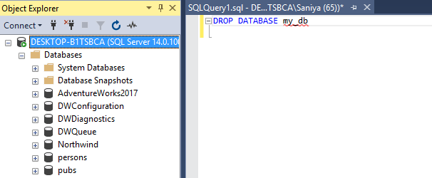
Drop Database statement

Slide 9
Create Table Statement
The CREATE TABLE statement is used to create a table in a database.
Syntax:
CREATE TABLE table_name
(
column_name1 data_type,
column_name2 data_type,
column_name3 data_type,
....
)

Slide 10
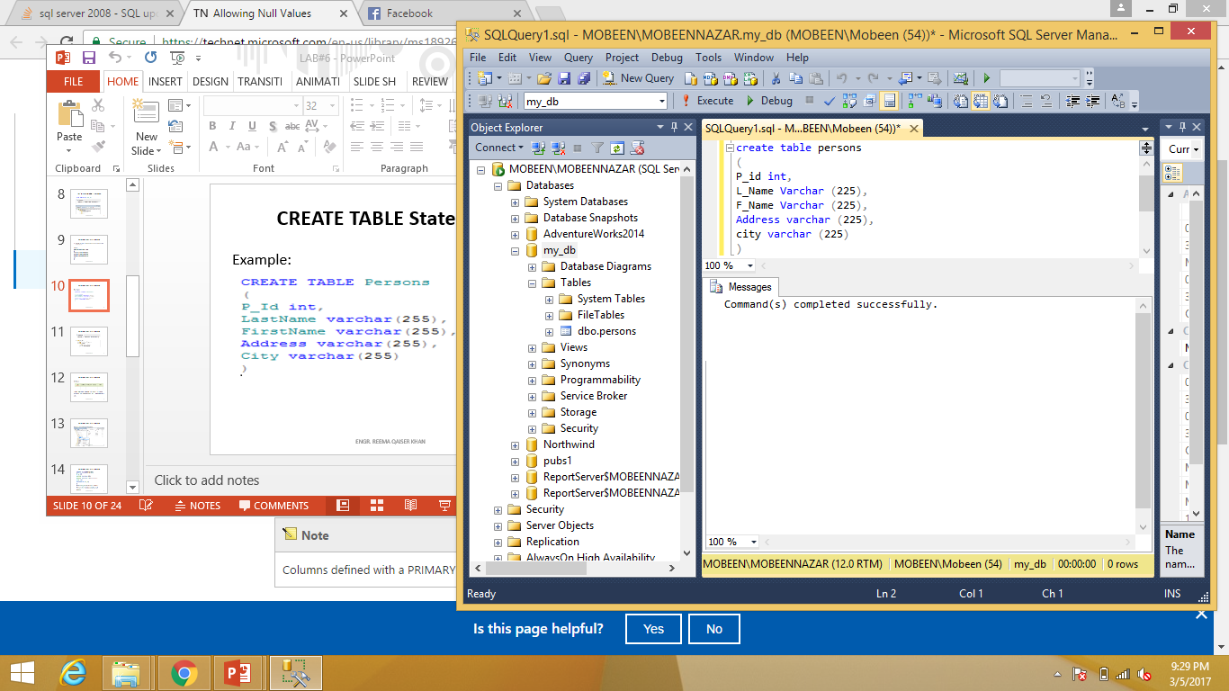
Create Table Statement

Slide 11
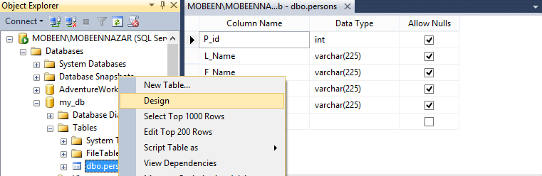
Create Table Statement
Right click on Persons Table and then click on Design.

Slide 12
Create Table Statement
CREATE TABLE EMPLOYEE (
P_Id INT,
LNAME VARCHAR (20),
FNAME VARCHAR (20) NOT NULL,
DOB DATE,
PRIMARY KEY(P_Id)
);
Note: Only those columns can be a Primary Key that do not allow null values.

Slide 13
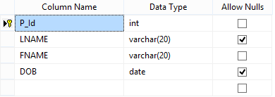
Create Table Statement

Slide 14
Create Table Statement
CREATE TABLE Department(
Dept_code INT,
P_Id INT,
PRIMARY KEY (Dept_code),
FOREIGN KEY (P_Id) REFERENCES Persons (P_Id)
);

Slide 15
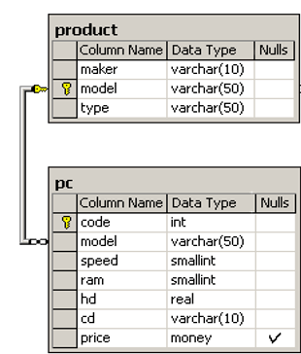
Create Table Statement

Slide 16
Drop Table Statement
The DROP TABLE statement is used to delete a table.
Syntax:
DROP TABLE table_name

Slide 17

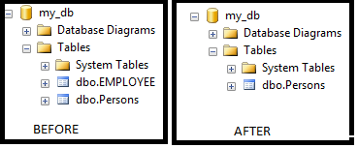
Drop Table Statement

Slide 18
Alter Table Statement
The ALTER TABLE statement is used to add, delete, or modify columns in an existing table.
Syntax:
ALTER TABLE table_name
ADD column_name datatype
ALTER TABLE table_name
DROP COLUMN column_name
ALTER TABLE table_name
ALTER COLUMN column_name datatype

Slide 19
Alter Table Statement
Example:
ALTER TABLE Persons
ADD DateOfBirth date
Example:
ALTER TABLE Persons
DROP COLUMN DateOfBirth

Slide 20
Alter Table statement
To allow naming of a PRIMARY KEY constraint,
and for defining a PRIMARY KEY constraint on
multiple columns, use the following SQL syntax:
ALTER TABLE <Table_Name>
ADD CONSTRAINT <Name_of _Constraint>
PRIMARY KEY
(<Column_Name>,<Column_Name>,…)

Slide 21
Alter Table statement
Example:
ALTER TABLE Persons
ADD CONSTRAINT P_Id PRIMARY KEY (P_Id)
Example:
ALTER TABLE Persons
ADD CONSTRAINT Pk PRIMARY KEY (P_Id,City)
Example:
ALTER TABLE Persons
DROP CONSTRAINT P_Id

Slide 22
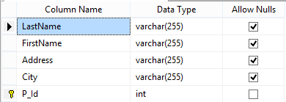
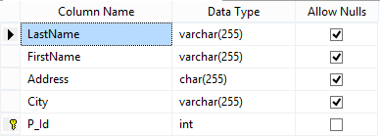
Alter Table Statement
Example:
ALTER TABLE Persons
ALTER COLUMN Address char(255)
BEFORE
AFTER

Slide 23
SQL CONSTRAINTS
SQL constraints are used to specify rules for the data in a table.
If there is any violation between the constraint and the data action, the action is aborted by the constraint.
Constraints can be specified when the table is created (inside the CREATE TABLE statement) or after the table is created (inside the ALTER TABLE statement).

Slide 24
SQL CREATE TABLE + CONSTRAINT Syntax
CREATE TABLE table_name ( column_name1 data_type(size) constraint_name, column_name2 data_type(size) constraint_name, column_name3 data_type(size) constraint_name, .... );

Slide 25
TYPES OF CONSTRAINTS
In SQL, we have the following constraints:
NOT NULL
UNIQUE
PRIMARY KEY
FOREIGN KEY
CHECK
DEFAULT

Slide 26
NULL CONSTRAINT
Indicates that a column cannot store NULL value
The NOT NULL constraint enforces a column to NOT accept NULL values.
The NOT NULL constraint enforces a field to always contain a value. This means that you cannot insert a new record, or update a record without adding a value to this field.

Slide 27
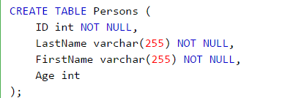
EXAMPLE-NULL CONSTRAINT

Slide 28
UNIQUE CONSTRAINT
Ensures that each row for a column must have a unique value
The UNIQUE constraint uniquely identifies each record in a database table.
The UNIQUE and PRIMARY KEY constraints both provide a guarantee for uniqueness for a column or set of columns.
A PRIMARY KEY constraint automatically has a UNIQUE constraint defined on it.
Note that you can have many UNIQUE constraints per table, but only one PRIMARY KEY constraint per table.

Slide 29
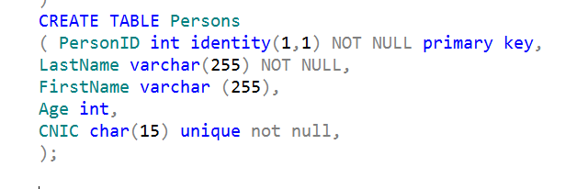
EXAMPLE-UNIQUE CONSTRAINT

Slide 30
PRIMARY KEY CONSTRAINT
A combination of a NOT NULL and UNIQUE. Ensures that a column (or combination of two or more columns) have an unique identity which helps to find a particular record in a table more easily and quickly
The PRIMARY KEY constraint uniquely identifies each record in a database table.
Primary keys must contain UNIQUE values.
A primary key column cannot contain NULL values.
Most tables should have a primary key, and each table can have only ONE primary key.

Slide 31
EXAMPLE-PRIMARY KEY CONSTRAINT

Slide 32
FOREIGN KEY CONSTRAINT
Ensure the referential integrity of the data in one table to match values in another table
A FOREIGN KEY in one table points to a PRIMARY KEY in another table.

Slide 33
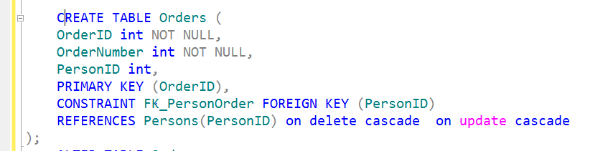
EXAMPLE-FOREIGN KEY CONSTRAINT

Slide 34
CHECK CONSTRAINT
Ensures that the value in a column meets a specific condition.
The CHECK constraint is used to limit the value range that can be placed in a column.
If you define a CHECK constraint on a single column it allows only certain values for this column.
If you define a CHECK constraint on a table it can limit the values in certain columns based on values in other columns in the row.

Slide 35
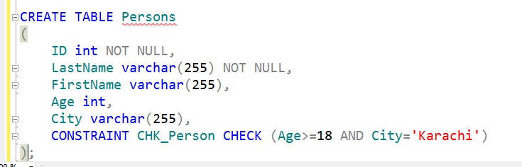
EXAMPLE-CHECK CONSTRAINT

Slide 36
DEFAULT CONSTRAINT
Specifies a default value when specified none for this column.
The DEFAULT constraint is used to insert a default value into a column.
The default value will be added to all new records, if no other value is specified.

Slide 37
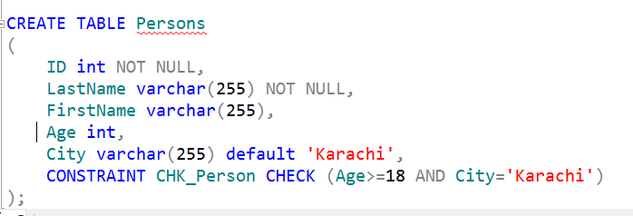
EXAMPLE-DEFAULT CONSTRAINT

Slide 38
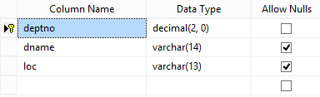
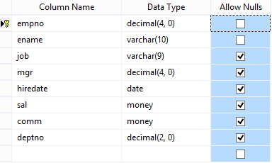
Tasks
1 Create Department table based on the following design:
2. Create Employee table based on the following design:

Slide 39
Tasks
3. Modify Employee table and add three more columns:

Slide 40
TASKS
4. Drop Column loc from Department table
5. Delete all record from Employee table
6. Drop Department Table.
7. Create database Authorization
Add a column ‘Address’ in Starsin table in database Authorization.
CREATE TABLE StarsIn ( movieTitle char(30), movieYear int,starName char(30) );

Slide 41
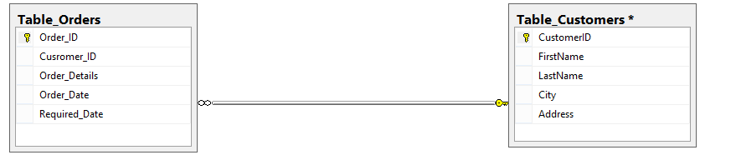
TASKS
8. Solve the Queries given below according to the following tables given below:

Slide 42
TASKS
Apply Not Null Constraint on all columns .
Apply primary key constraint in OrderID and customer ID.
Apply foreign key constraint on Customer _ID in Order table.
Apply check constraint on city (allow Karachi, Islamabad, Lahore only).
Set the default value of City as ‘Karachi’.
Add CNIC column in Customer table with unique constraint.

Slide 43
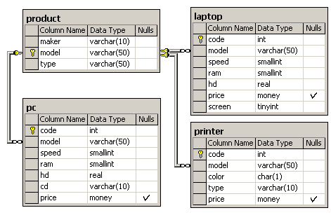
TASKS
Create the following tables given in diagram with constraints (PK-FK relationship).

